Slide 1
Module 4: The World of Digital Misinformation
Week 7

Slide 2
Overview
What is Fake News?
Why it is important to spot Fake News?
Short and long-term consequences
Different ways of fighting fake news
Fact-checking
Any other tools?

Slide 3
Fake News
A specific type of falsehood intentionally packaged to look like news to deceive others – Fake News
A statement is false if it is false or misleading, whether wholly or in part, and whether on its own or in the context in which it appears - Falsehoods
The inadvertent dissemination of false information - Misinformation
The intentional dissemination of false information - Disinformation

Slide 4
Motivations for Fake News
Financial
⁃ Attracting clicks
⁃ Advertising revenues
• Ideological
⁃ Personal agenda
⁃ Weapons of mass misinformation

Slide 5
How to spot Fake News?
Sender
⁃ Credible or familiar?
⁃ Trustworthy or similar?
⁃ Proximate or distal?
Message
⁃ Format
⁃ Plausibility
Channel
⁃ Trusted or depended on?
⁃ Closed or open?
⁃ Feedback
Receiver
⁃ Confirmation bias
⁃ Motivations
⁃ Corrections
• Context
⁃ Information overload
⁃ Instability

Slide 6
How to spot Fake News?
Focus on the Message Characteristics
• Plausible?
• Mentions experts?
• Conversational tone?
• Stirs emotion?
• Asks you to forward?

Slide 7
Different ways of fighting fake news
Individuals
Governments
Tech-companies
Journalists and fact-checkers

Slide 8
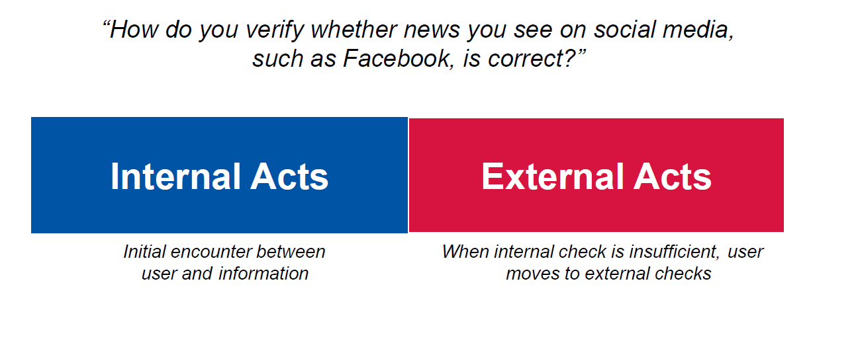
Fighting fake news - Individuals

Slide 9
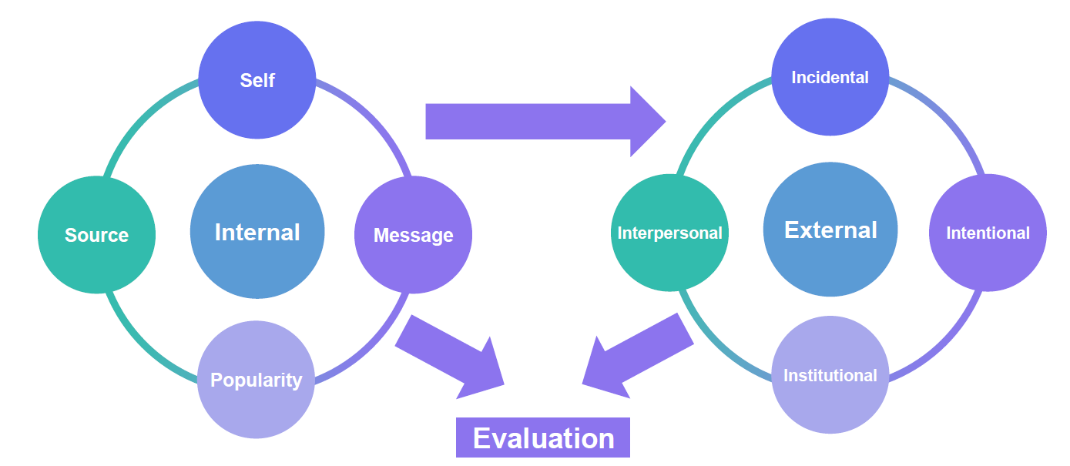
Fighting fake news - Individuals

Slide 10

Fighting fake news – Fact-checking tools

Slide 11
Module 4 Tutorial
In this week module 4 activities, the students will learn the ways to identify fake news, understand the adverse consequences of fake news, and the importance of fighting fake news. Upon completion of the lesson, students will be able to understand the importance of fact-checking to determine the authenticity of news in the digital world.
Activity 1: Importance of Fact-Checking
Each group to select any two online news or postings from the given lists and discuss on the questions asked.

